Slide 1

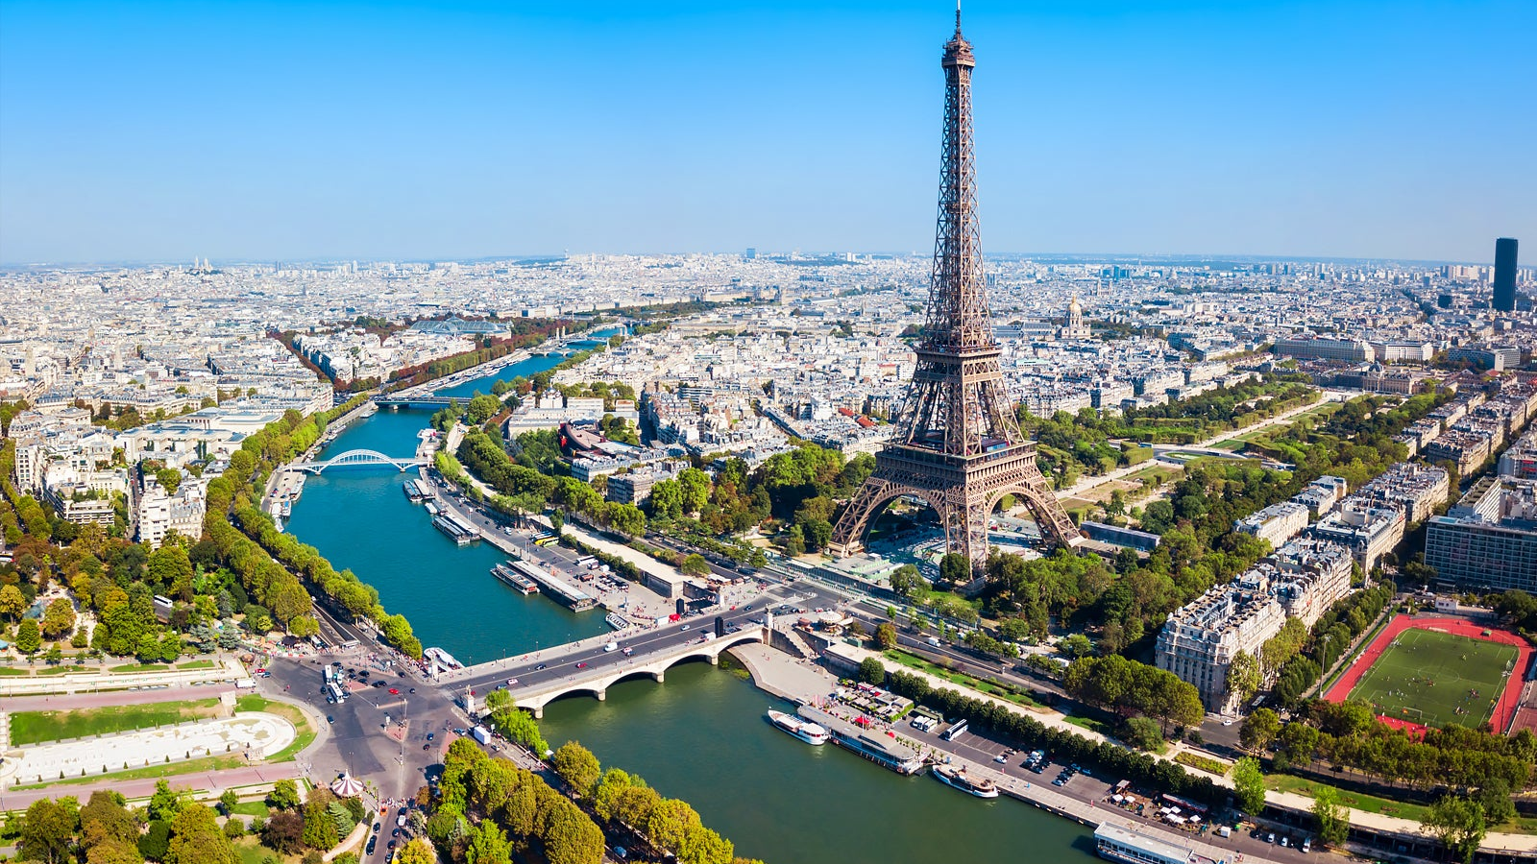
Famous tourist destinations
- PARIS -

Slide 2

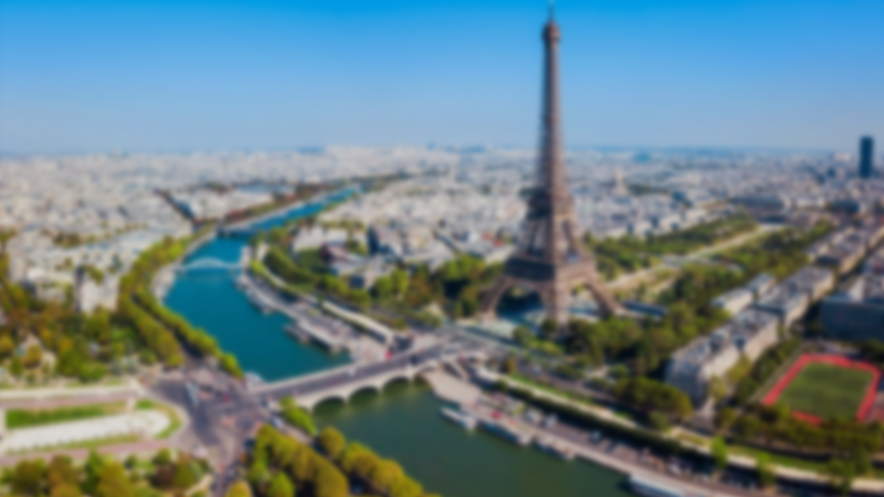
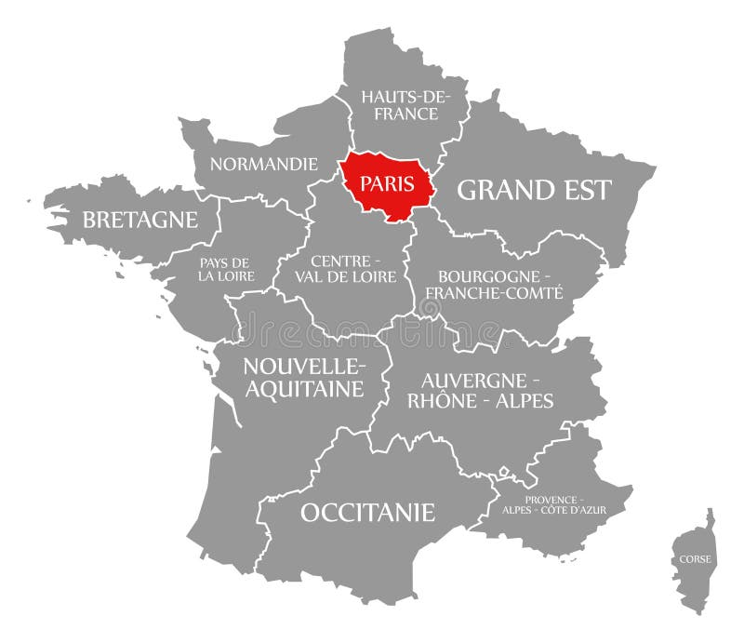
PARIS: AN OVERVIEW
Famous tourist destinations
- PARIS -
Paris is the capital and largest city of France, famously known as the "City of Light" due to its pivotal role during the Age of Enlightenment and its early adoption of street lighting.
Situated in the Île-de-France region, Paris is built along the Seine River, with the city center lying on its historic island, Île de la Cité.
It spans approximately 105 square kilometers and has a metropolitan population exceeding 11 million, making it a hub for economic and cultural activity.
The state of Paris on a map of France

Slide 3
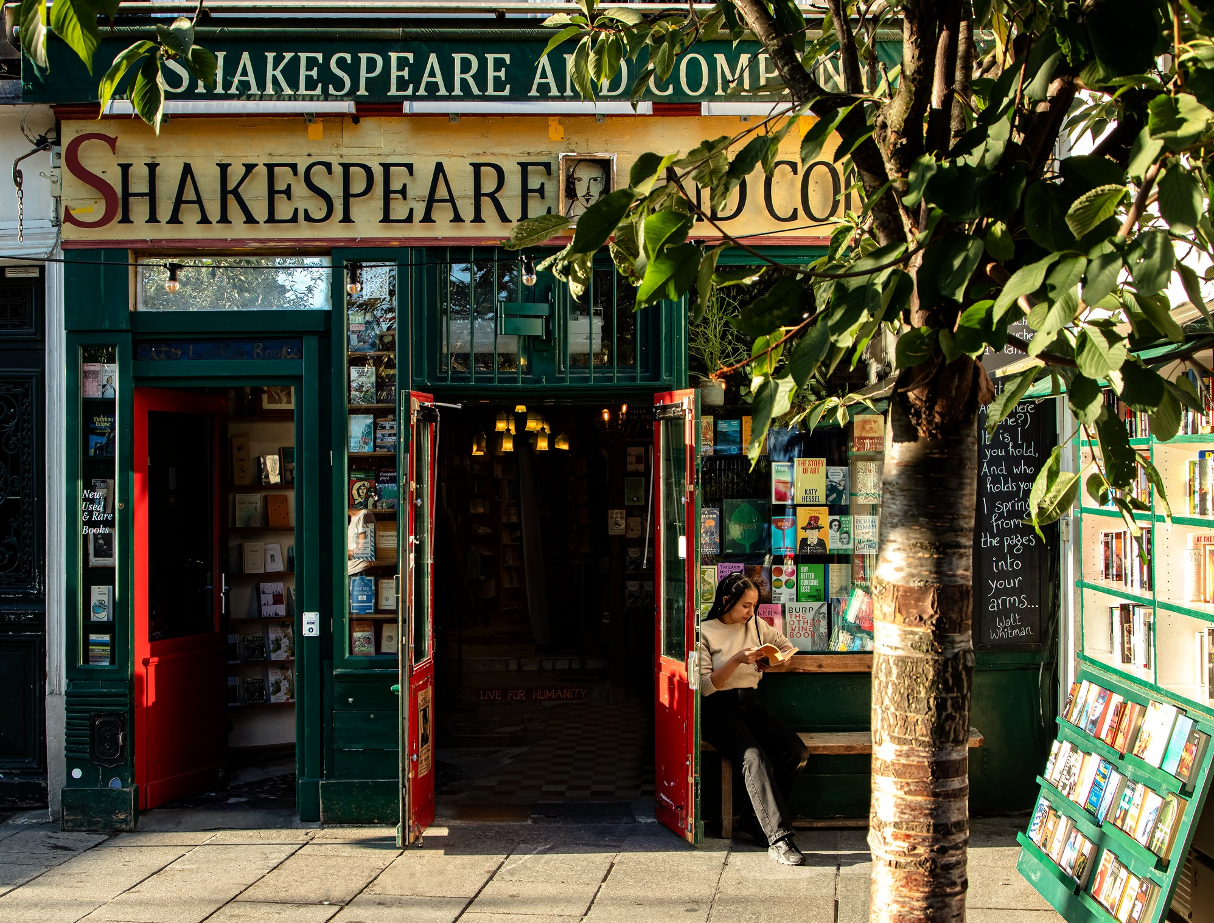
Cultural Significance of Paris
Paris is identified with art, literature and fashion, often regarded as the cultural capital of the world.
It’s home to legendary institutions such as the Louvre, housing masterpieces like the Mona Lisa and the Venus de Milo.
Paris is also the birthplace of haute couture, with major fashion houses like Chanel, Dior, and Louis Vuitton headquartered in the city.
The city's café culture and historic bookshops, such as “Shakespeare and Company”, add to its intellectual charm.
Picture of a “Shakespeare and Company” bookshop

Slide 4
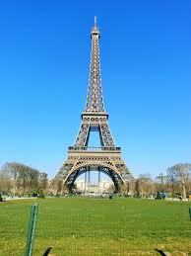
The Iconic Eiffel Tower
The Eiffel Tower, constructed for the 1889 World’s Fair, was initially criticized by Parisians but later became a global symbol of France.
At 324 meters tall, it remained the tallest man-made structure in the world until 1930.
Today, the tower attracts nearly 7 million visitors annually, offering breathtaking views from its three levels.
It is illuminated nightly with 20,000 twinkling lights, adding to its allure as a romantic landmark.
The Eiffel Tower

Slide 5
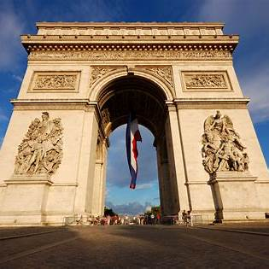
The Majestic Arc de Triomphe
Commissioned by Napoleon Bonaparte in 1806, the Arc de Triomphe honors those who fought and died for France during the Revolutionary and Napoleonic Wars.
The monument features detailed reliefs depicting key battles and military achievements.
Beneath its arches lies the Tomb of the Unknown Soldier, marked by an eternal flame commemorating World War I casualties.
The Arc de Triomphe influenced the design of the Arch of Triumph in Bucharest, Romania, built to celebrate Romania’s independence and honor its soldiers after
World War I.
The Arc de Triomphe

Slide 6
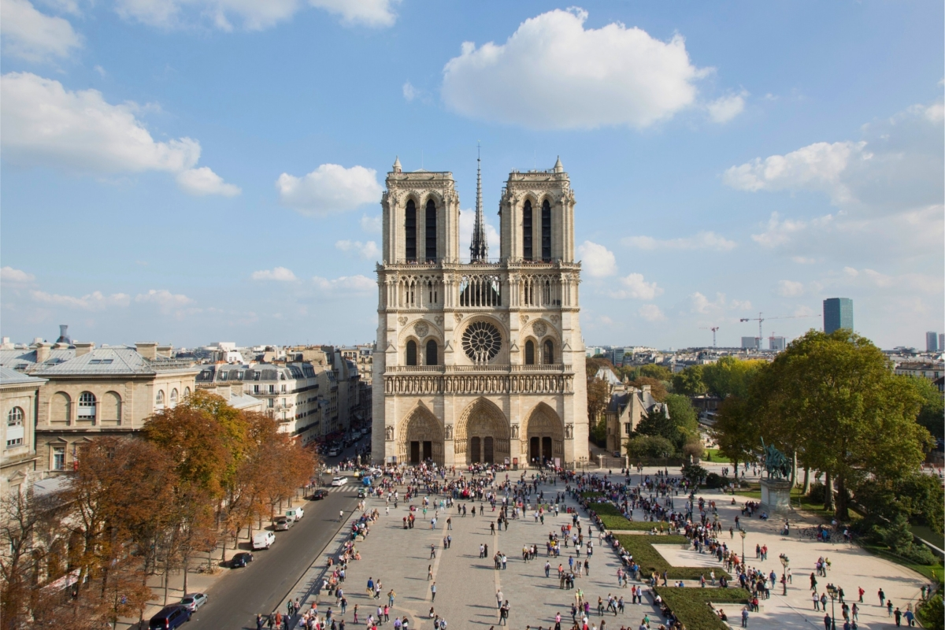
The Majestic Notre-Dame Cathedral
Notre-Dame de Paris is one of the most famous Gothic cathedrals in the world, located on the Île de la Cité in the heart of Paris.
Construction began in 1163 and was completed in 1345, making it an architectural masterpiece with stunning stained glass windows, intricate sculptures, and flying buttresses.
The cathedral is home to significant relics, including what is believed to be the Crown of Thorns, worn by Jesus Christ during his crucifixion.
In 2019, a devastating fire severely damaged the building, but restoration efforts are underway to restore this iconic landmark to its former glory.
Notre-Dame's iconic bell towers, which are over 69 meters tall, offer panoramic views of the city from the top.
Notre Dame

Slide 7
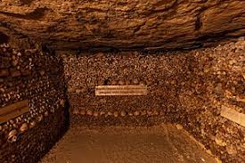
Interesting Facts About Paris
Paris was originally a Roman city named "Lutetia" and has a history spanning over 2,000 years.
The Eiffel Tower was once used as a giant radio antenna and played a role in transmitting signals during World War I.
The city has more than 450 parks and gardens, including the beautiful Luxembourg Gardens and Bois de Boulogne.
Paris is known for its unique underground catacombs, which house the remains of over 6 million people, arranged in artistic formations.
There’s only one stop sign in the entire city of Paris, located in the 16th arrondissement, due to the prevalence of roundabouts and
priority-to-the-right rules.
One of the catacombs in Paris

Slide 8

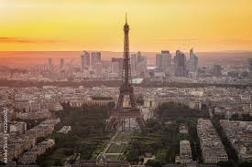
Conclusions
Paris is a city where history and modernity intertwine seamlessly, offering an unparalleled cultural and architectural experience.
From its iconic landmarks like the Eiffel Tower and Notre Dame Cathedral to its charming neighborhoods such as Montmartre and Le Marais, Paris caters to every traveler’s interests.
Known as the city of love and romance, Paris continues to inspire artists, writers, and dreamers worldwide.
Its influence extends beyond borders, shaping global art, cuisine, and fashion for centuries.
Visiting Paris is not just a trip but a journey into a city that celebrates beauty, creativity, and the human spirit.
Paris Skyline, with Eiffel Tower

Slide 9

The reason we have chosen Paris
1. Paris is, as discussed, one of the most popular tourist destinations, so we have chosen Paris since of its easy accessibility to information about this beautiful city. 2. Mocanu will go this holiday in Paris
Text: Wikipedia Images: Wikipedia /
first ones on Google
WEBOGRAPHY

